Slide 1
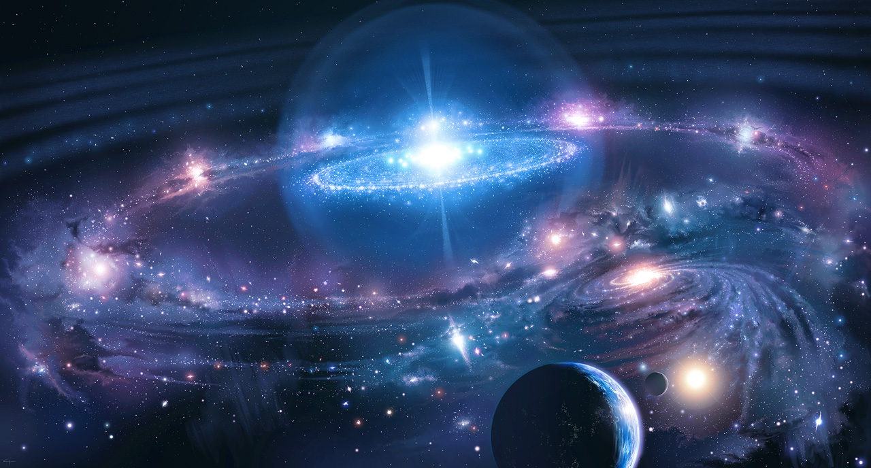
Origins of the Universe

Slide 2
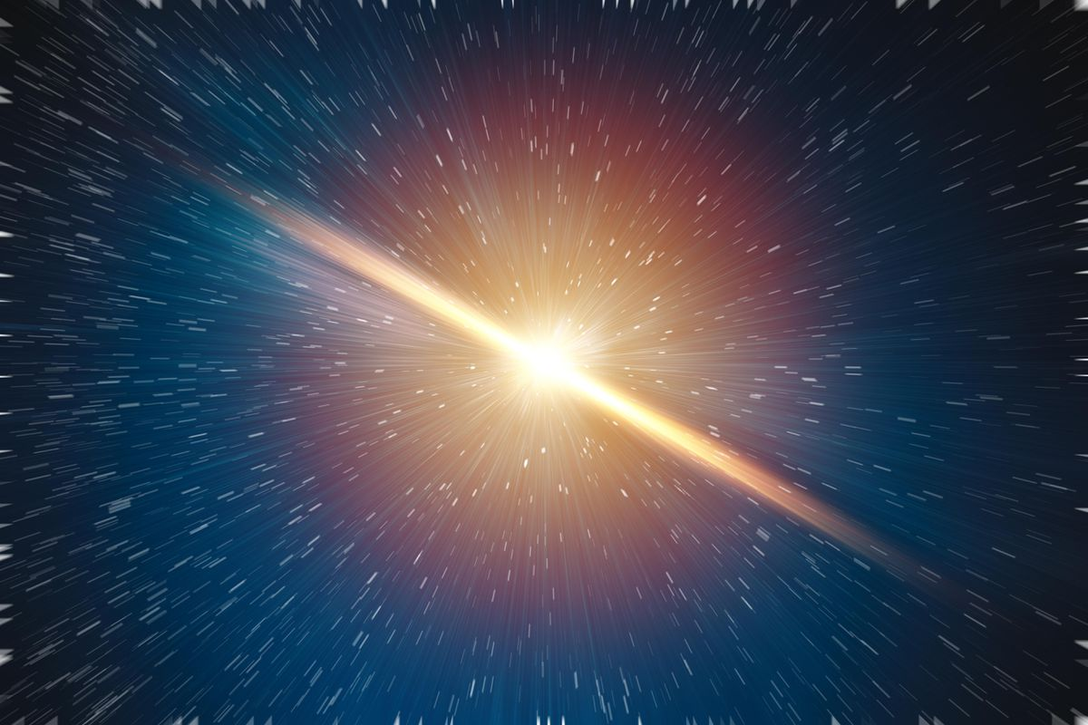
Lesson Objectives
Describe the Big Bang theory
Describe a variety of pieces of evidence that support the Big Bang
Activating prior knowledge
Think-pair-share: With your partner discuss your understandings (or lack of understandings) of the origin of the universe

Slide 3
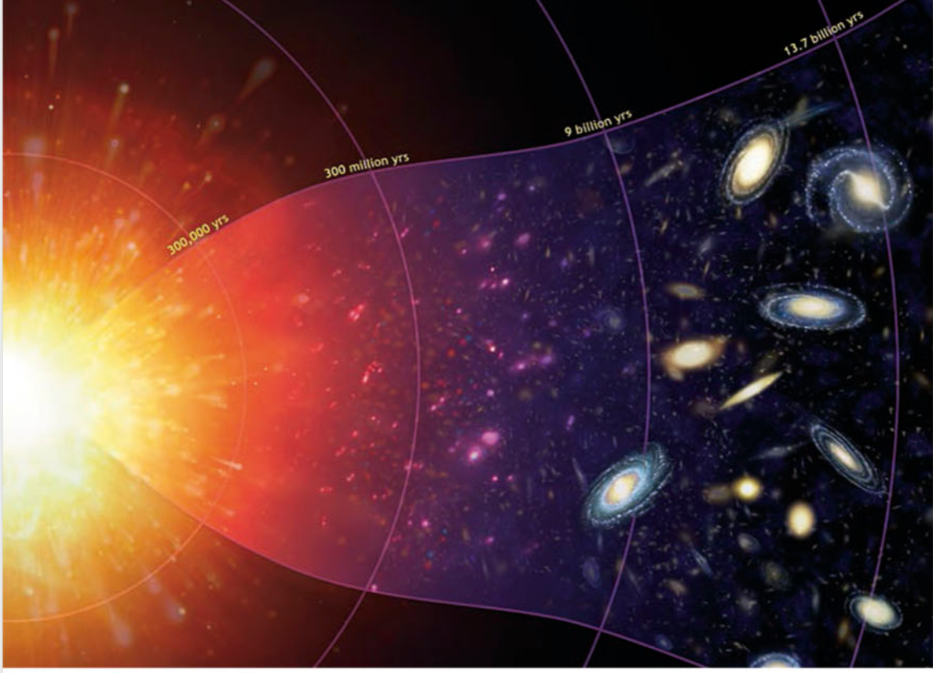
What is the Big Bang Theory?
A theory that describes how the universe developed from a small dense singularity into the massive expanded space it is today.
It is still expanding and will continue to expand infinitely.
Contrary to popular belief, it was not an explosion, rather a rapid, silent expansion.
https://www.youtube.com/watch?v=GncYOf29uc4

Slide 4
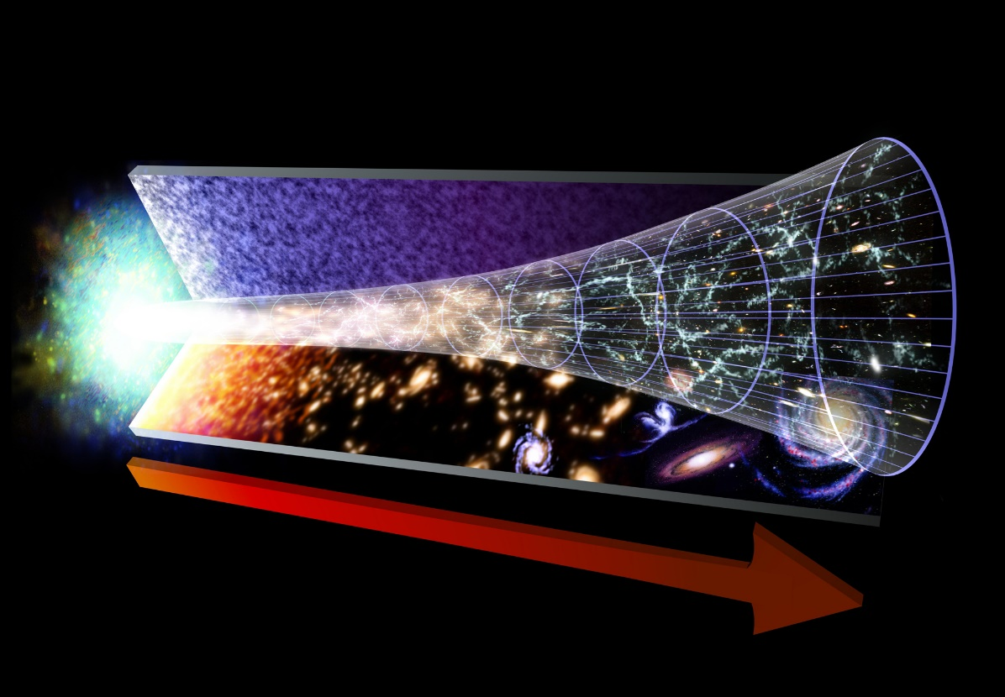
Prior to the Big Bang
14 Billion years ago our universe emerged from singularity
Singularity is a point of infinite density and gravity from which our universe began
Prior to this there was no time or space as we know it
The big bang then occurred leading to the rapid expansion of space and cooling, gradually forming small atoms followed by larger and larger atoms over millions and billions of years

Slide 5
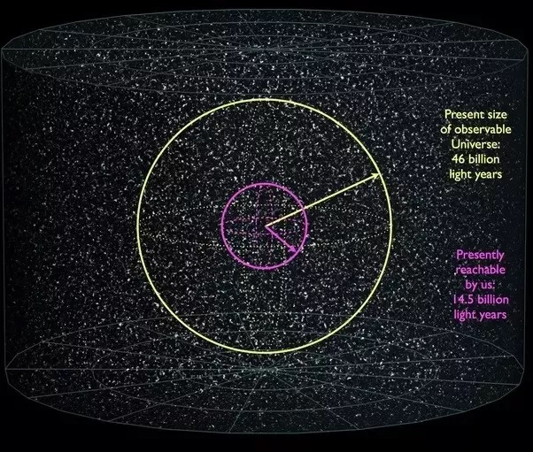
Hubble’s discovery
In the early 1920’s Edwin Hubble was studying space in which he viewed some cloud like structures. These were thought to be a collection of dust and gas within our galaxy, known as a nebula.
He later realised that these clouds were in fact other galaxies much like our own. Each containing billions of stars and solar systems.
It is estimated that we can observe roughly 150 billion galaxies, however we believe that there are many more than this.

Slide 6
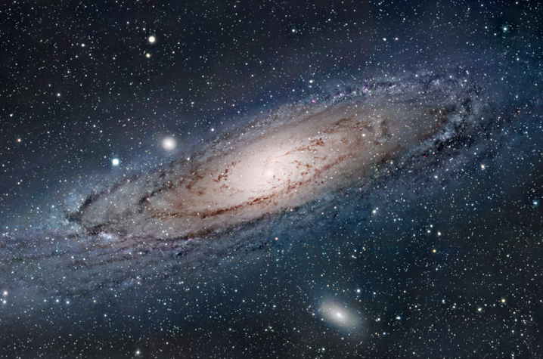
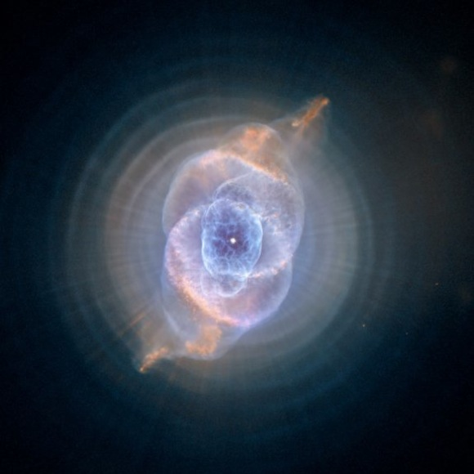
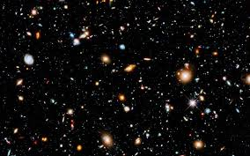
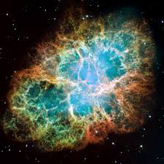
Nebula vs Galaxies
Galaxy (Milky Way)
Nebula
Hubble deep field – photo of many galaxies
Notes:
Notes: Previous slide stated that Hubble believed he was looking at Nebulae which are shown on the left (Crab nebula on the bottom, a planetary nebula on the top).
Nebula exist within galaxies, as such are smaller structures relative to a galaxy.
In fact what Hubble was looking at was many different galaxies similar to our own (Milky Way galaxy)
Bottom right is a photo of Hubble deep field – this is NOT the photo Hubble was referring to however it shows a similar idea. Each of the glowing structures are Galaxies, not nebulae

Slide 7
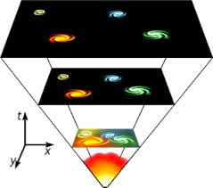
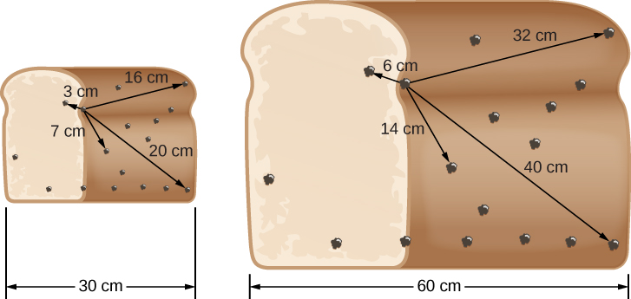
Hubble’s expanding universe
In 1929 Hubble noticed that all of the galaxies appeared to be moving away from our own, however some faster than others.
From this observation Hubble theorised that all galaxies are moving away from each other, and therefore the entire universe is expanding

Slide 8
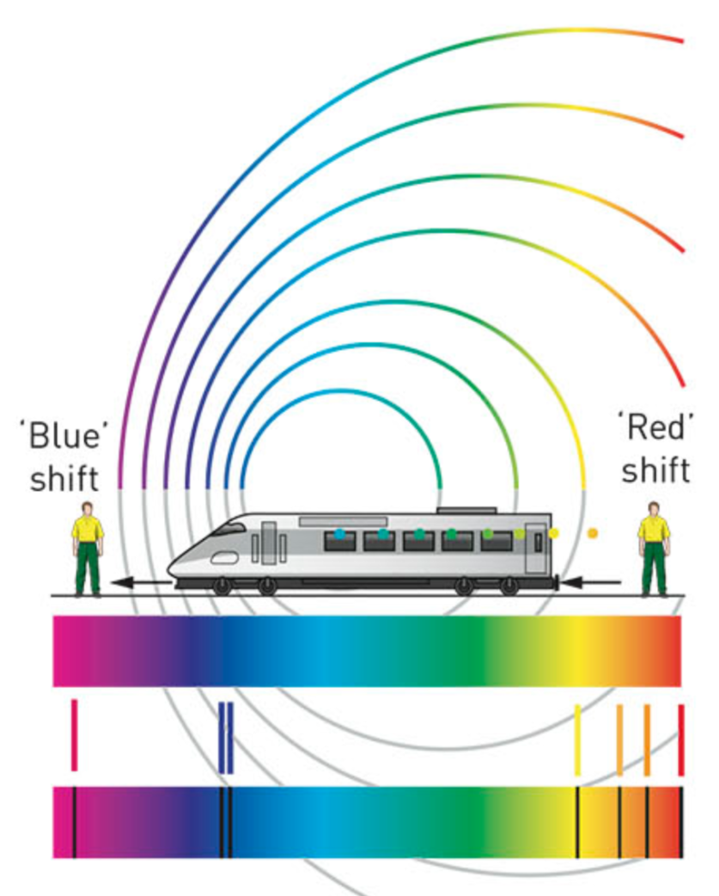
Hubble’s expanding universe
This observation was made due to Red shift
Objects that are moving away from an observer, if moving fast enough, the frequency of the light decreases, making the light appear more red
Scientists used this understanding of an expanding universe to create the big bang theory as everything is expanding away from a single point which is where the big bang is thought to have occurred.

Slide 9
Events after the big bang
1 second – the first particles formed consisting of protons and neutrons
3 seconds – the first simple elements formed (H, He, Li)
300,000 years – Increasing amounts of matter began to form as the universe cooled
300m years – The first stars are born, groups of these stars will form the earliest galaxies
9.5b years – Our sun and solar system is born, the Earth is formed shortly after
11.5b years – First life on earth began
14b years – Current time
https://www.youtube.com/watch?v=Bl-s4tqR8Bc

Slide 10
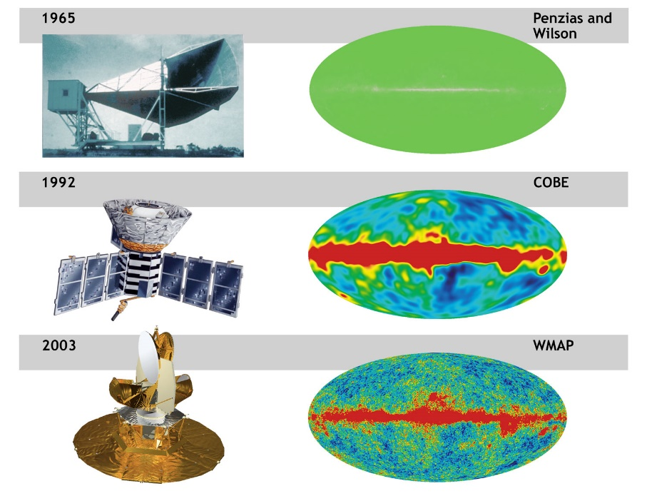
Evidence for the big bang
All theories are based on strong evidence, the big bang theory is no different
The first pieces of evidence for the Big Bang was Hubble’s observation of Red shift
The second form of evidence was the discovery of Background radiation
It was hypothesised that if the Big Bang did occur, all of the heat released in the Big Bang would still exist in a much cooler form
Penzias and Wilson accidentally discovered this radiation in 1965 – Cosmic background radiation

Slide 11
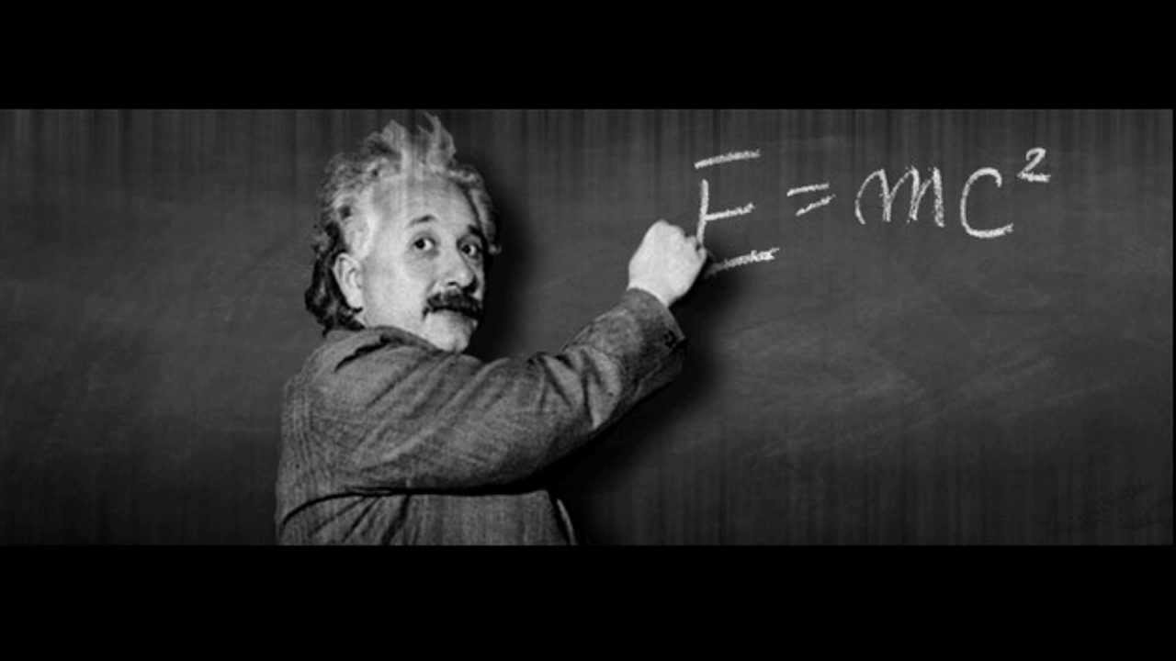
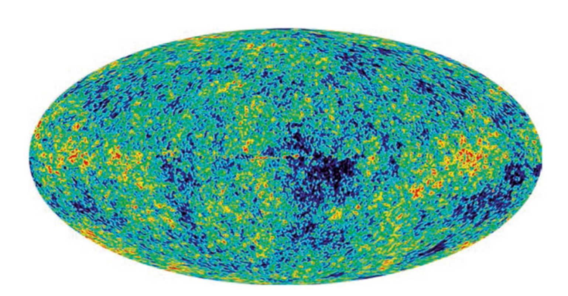
Evidence for the big bang
All theories are based on strong evidence, the big bang theory is no different
The third form of evidence is the mixture of elements present in the universe
As the universe cooled energy was converted into matter
The abundance of simple elements (H, He) in the observable universe matches what we would expect if all of the universe was once condensed into one point
Therefore in areas where there are large amounts simple elements (H, He) the universe is cooler
1992 – Cosmic Background Explorer satellite detected ripples in temperature fluctuations that were consistent with the formation of distant galaxies and older stars

Slide 12
Summary VIdeo
https://www.youtube.com/watch?v=xtrYF_hxxUM

Slide 13
Relevance
The evidence is overwhelming enough that in 1951, the Catholic Church officially announced the big bang model to be in accordance with the Bible.
Until the early 1900s, most people had assumed that the universe was fixed in size.
New possibilities opened up in 1915, when Einstein formulated his famous general relativity theory that describes the nature of space, time, and gravity.

Slide 14
Skill closure
Describe the big bang theory
Describe the Red Shift and explain how this supports the expansion of the universe.
List the two other pieces of evidence supporting the big bang and briefly explain how one of these pieces of evidence supports the big bang.

